Slide 1
Citi Bike Data Analysis
By Jamey Stevens

Slide 2
Project Goal:
To better understand the behavior of Citi Bike’s customer base (both one-time users and subscribers) and how they use Citi Bikes
This will help us to:
Identify where more bikes should be installed
Create targeted marketing campaigns that will appeal to different customer segments

Slide 3
Key questions:
What are the most popular pick-up locations across the city for Citi Bike rental?
How does the average trip duration vary across different age groups, and over time?
Which age group rents the most bikes?
How does bike rental vary across the two user groups (one-time users vs long-term subscribers) on different days of the week?
Do factors like weather and user age impact the average bike trip duration?

Slide 4
Findings & Insights

Slide 5
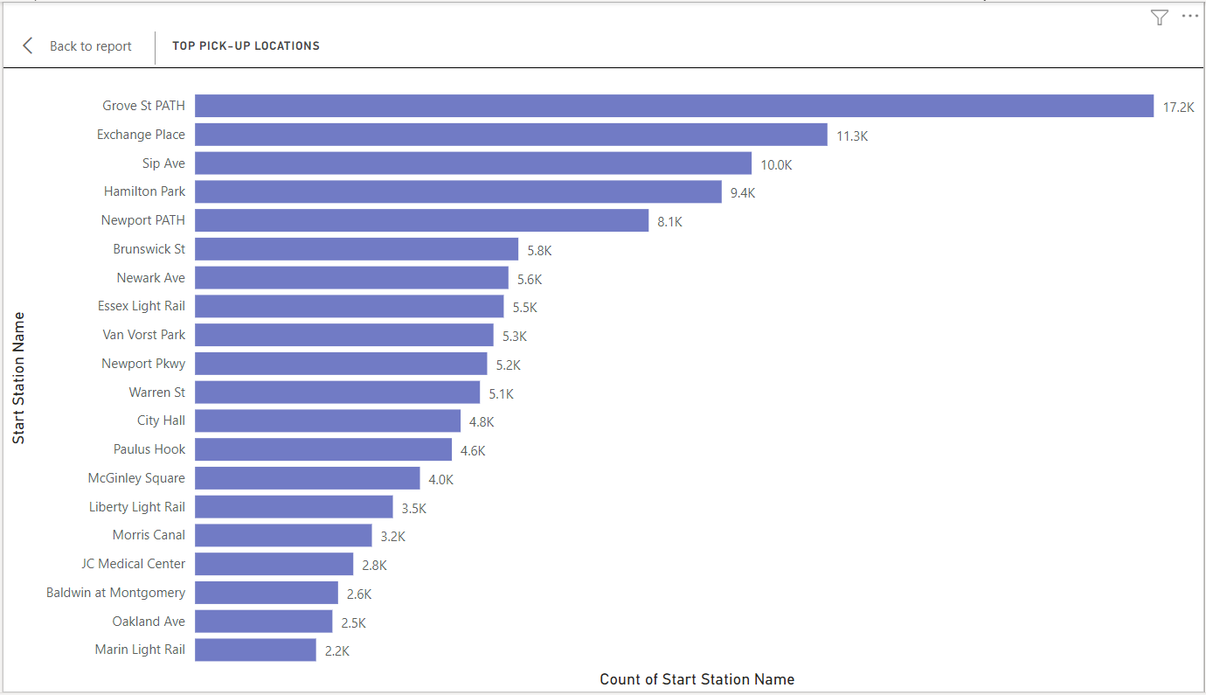
What are the most popular Citi Bike pick-up locations?

Slide 6
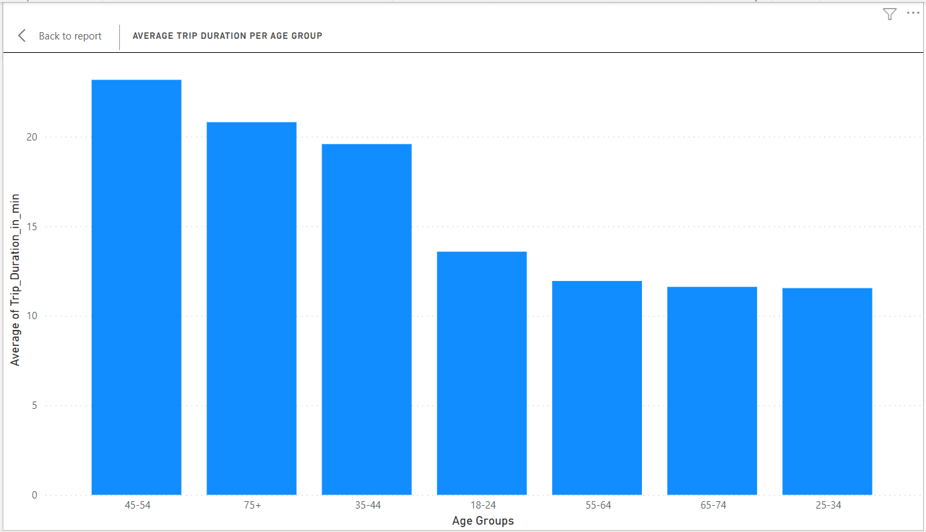
2. How does the average trip duration vary across different age groups, and over time?
45-54 year olds take the longest trips (on average)
65-74 and 25-34 year olds take the shortest trips (on average)

Slide 7
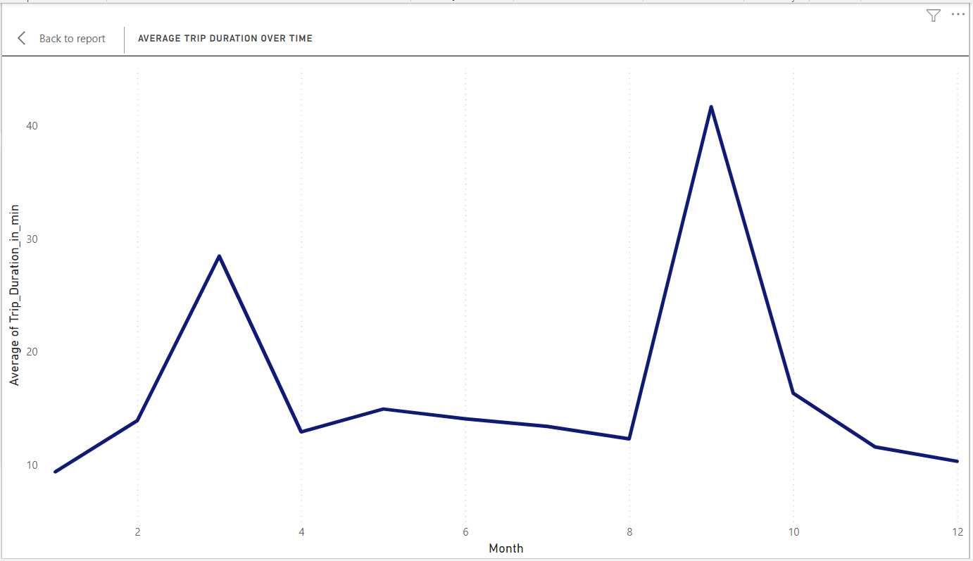
2. How does the average trip duration vary across different age groups, and over time?
September = longer trip durations

Slide 8
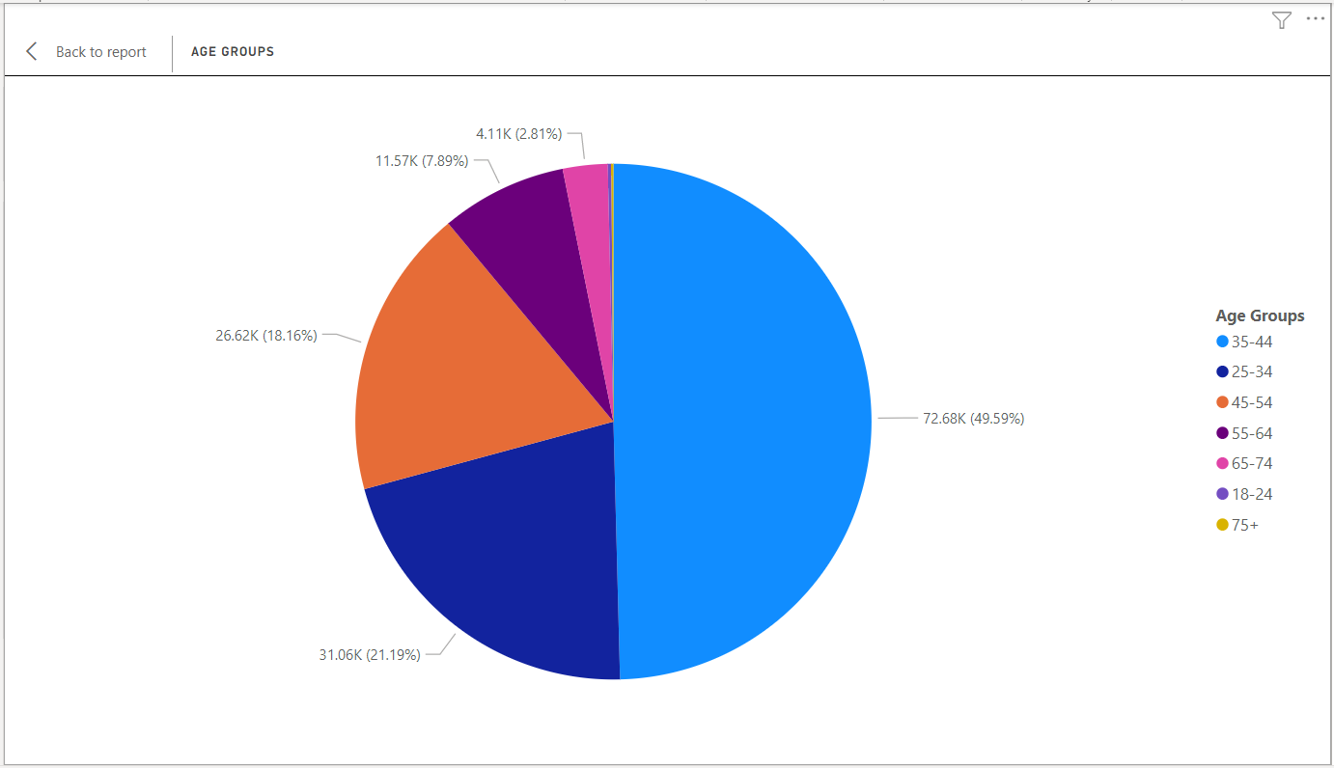
3. Which age group rents the most bikes?
35-44 year olds rent the most bikes
75+ and 18-24 year olds rent the least bikes

Slide 9
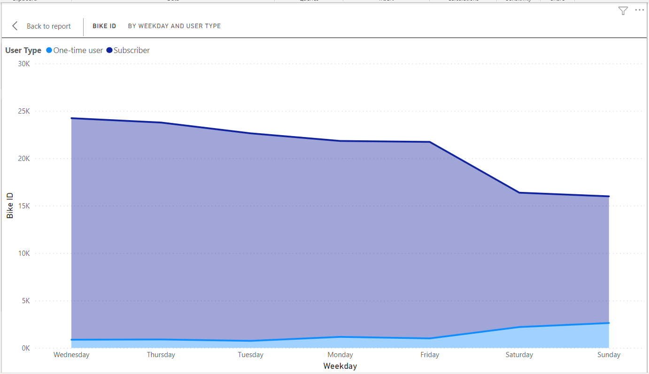
4. How does bike rental vary across the two user groups (one-time users vs long-term subscribers) on different days of the week?
Citi Bike customer base is predominantly made up of long-term subscribers
Subscribers are more active during the week
One-time users are more active on weekends

Slide 10
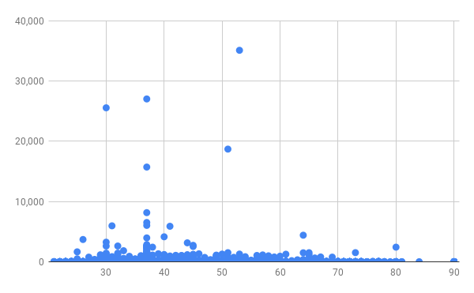
5. Do factors like weather and age impact the average bike trip duration?
No relationship between user age and trip duration

Slide 11
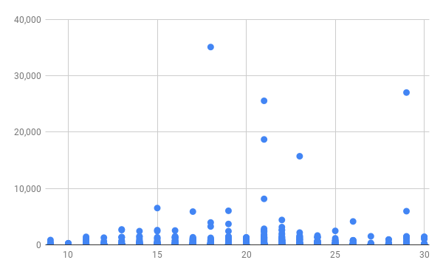
5. Do factors like weather and age impact the average bike trip duration?
Warmer temperatures = longer Citi Bike rides

Slide 12
Summary

Slide 13
Summary of findings:
Top 5 pick-up locations for bikes:
Grove St Path, Sip Ave, Newport Path, Newark Ave, Van Vorst Park
Customer base:
Mostly long-term subscribers who are more active during the week
One-time users more active at weekends
Most bikes rented by 35-44 year olds
Citi Bike customer behavior:
75+ year olds take longest average trips, but rent the least bikes
65-74 and 25-34 year olds take the shortest trips on average
Longer trips in warmer temperatures → September = longest bike rides

Slide 14
Actions & Recommendations

Slide 15
Recommended actions:
Product recommendations:
Install more bikes at Grove St Path, Sip Ave, Newport Path, Newark Ave, Van Vorst Park.
Make more bikes available in autumn, as this is when Citi Bike users take the longest trips (which means bikes will be unavailable for longer)
Marketing recommendations:
The Citi Bike customer base is mostly long-term subscribers aged between 35-44, who are most active during the week. This tells us that they are probably people who live in New York and use Citi Bikes to commute. Marketing and advertising campaigns should therefore target this particular demographic.

Slide 16
Thank you!

